Slide 1

מנחה מקצועית:
טליה מרמור בן רעי
מנחים אקדמים:
ד"ר ארנון שטורם
ד"ר יוסי אורן
סטודנטים:
שי דיין
רועי פילר
מגל וייס

Slide 2

Background
Excellent writing skills significantly help to get opportunities in the real world
There is a need for modern tools for effective and fast writing skills improvement
There is a need for attracting students in the fast growing technology world

Slide 3
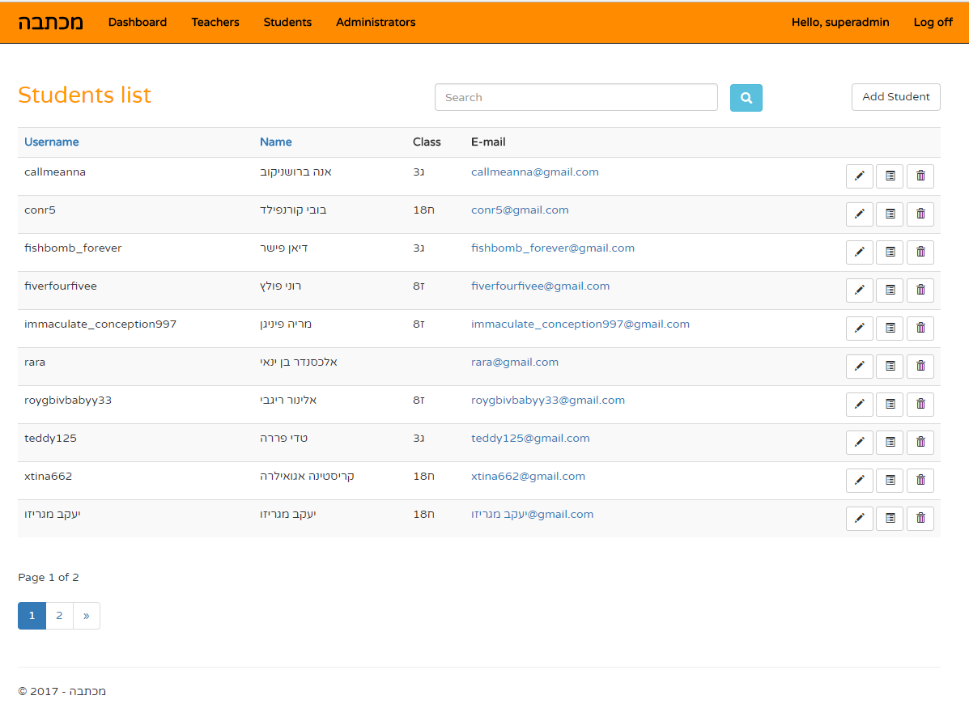
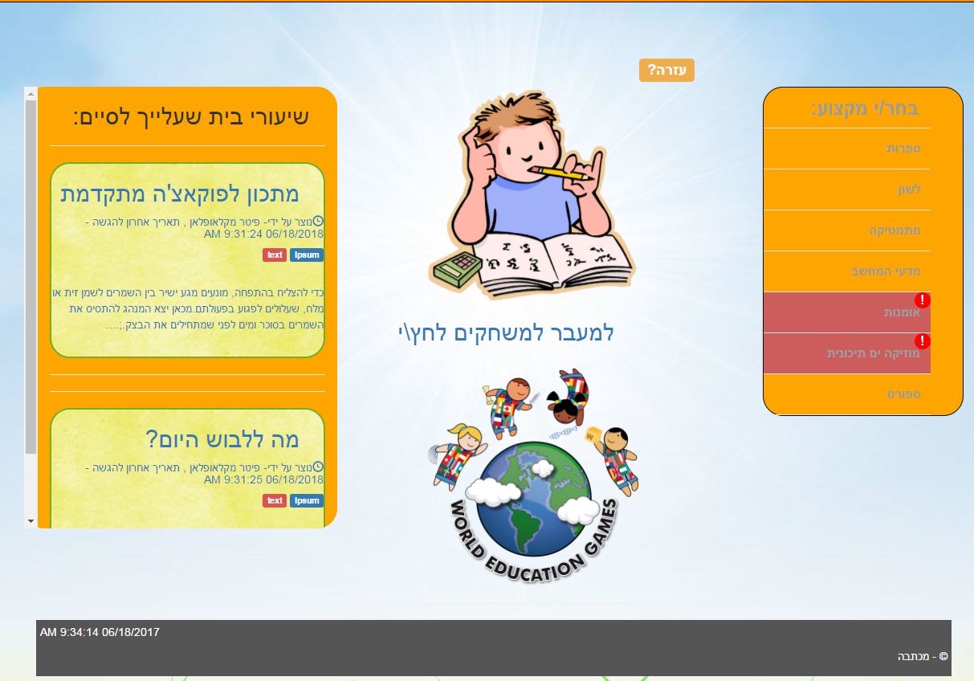
Michtava Solution
Friendly WEB learning system
Three system roles – Student, Teacher and Administrator
Uploading and managing contents
Smart Textbox for supporting and improving students’ answers in real-time

Slide 4





Choosing The Technology
 | Entity Framework | Availability for different devices and operating systems | Easy deployment And software updates | Easy use of libraries and extensions

Slide 5
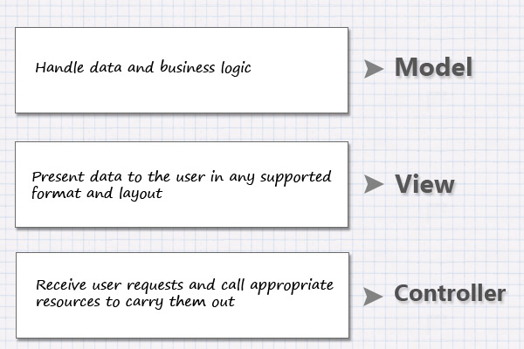
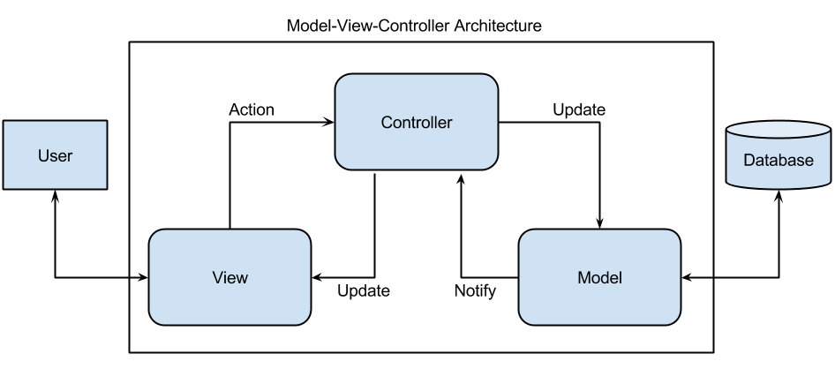
MVC Architecture

Slide 6
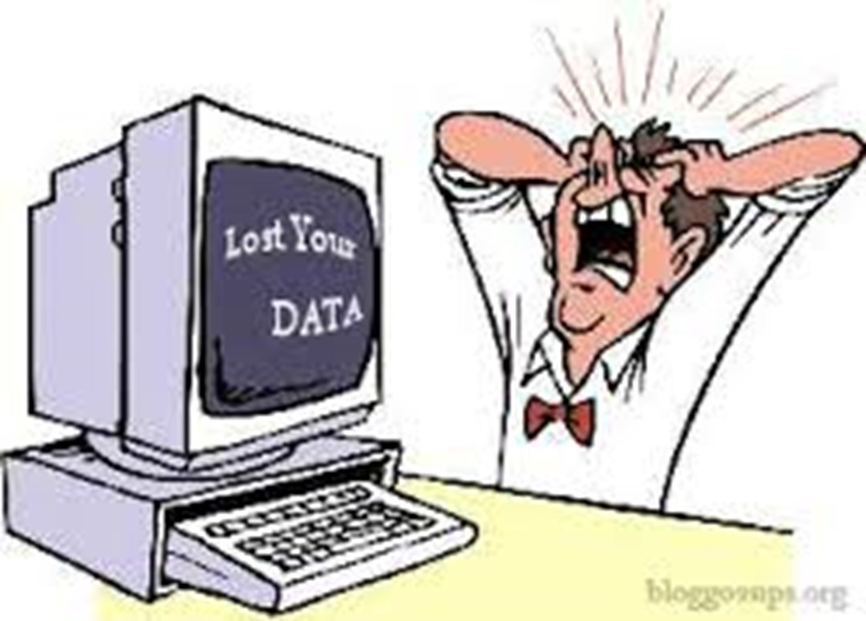
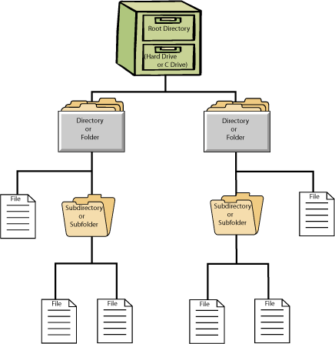
Challenge 1
The Problem: Data loss in case of connection issues and system errors.
The Solution: Temporary Files System.
Managing temporary folders and files
Writing Objects into files and parsing files into Objects
Unique folder per session

Slide 7

Challenge 2
The Problem: Every small change in the business model leads to a complex migration process and slows down the development.
The Solution: Automatic migrations.
Schema changes create DB migrations automatically
Seeded data is recreated to match the new DB scheme
Makes changing the data model very comfortable and viable even late in development and after releasing to the customer

Slide 8
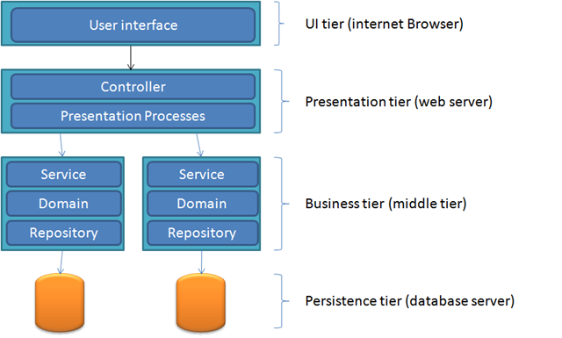
System Architecture
SmartTextBox
Service
Logic
FileHandler
Service
Logic

Slide 9
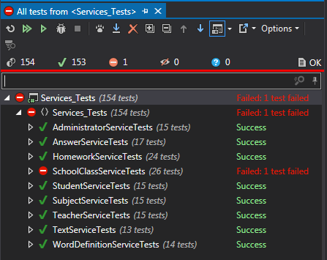

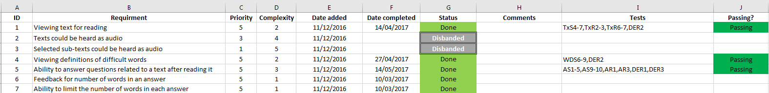
The Development Process
Version control with Bitbucket
Requirement traceability document
Manual and automated tests per requirement
Independent software components and work areas
Task prioritization
Team meetings

Slide 10
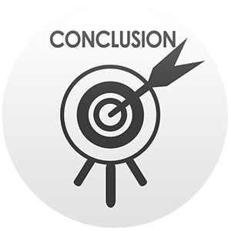
Conclusions
First time dealing with a large scale project management and development.
Working tight with some documents was very helpful (RTM) and with some of them not.
Better UI planning could have caused less UI changes through the development and easier testing.
Good communication was needed and helped us to complete the project as planned.
The most important thing was keeping the team’s spirit.

Slide 11

Demo

Slide 12

Q & A
Thank You!

